Slide 1

Customer segmentation
Understanding Customers Through Data-Driven Segmentation
SIC – AI801

Slide 2
Agenda
Team Members
Problem Statement and Dataset Overview
EDA
Data cleaning & Pre-processing
Machine Learning Model
Evaluation For Model
Conclusion (Our Recommendations)
Samsung Innovation Campus

Slide 3





Team Members
Yossef Haytham
Mohamed Ashraf
Mazen Hassan
Mohab Harfoush
Menna Mohamed
Samsung Innovation Campus

Slide 4
Problem Statement and Data
Samsung Innovation Campus

Slide 5
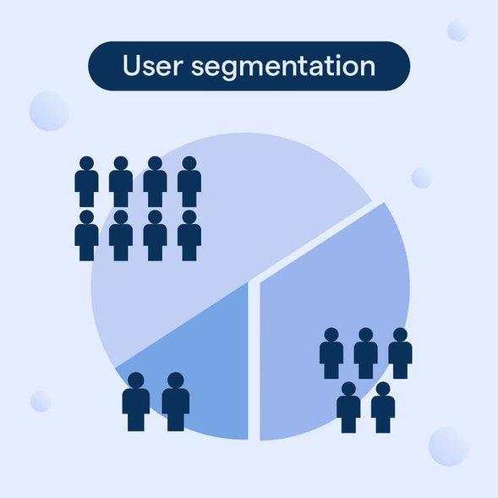
Problem Statement
Customers are not all the same.
▶Customer Diversity: Customers differ in needs, preferences, spending behaviors, and engagement levels.
▶The Risk: Applying a "one-size-fits-all" approach leads to ineffective marketing strategies.
▶The Solution: Understand customer behavior to create tailored, personalized strategies for each segment.
Samsung Innovation Campus

Slide 6
Data Overview
Dataset: Customer Personality
2,240 customers
29 columns
6 Categories
Category | Key Columns
Customer Profile | ID, Year_Birth, Education, Marital_Status, Income
Family Info | Kidhome, Teenhome
Customer Activity | Dt_Customer, Recency
Product Spending | MntWines, MntMeat, MntGoldProds, etc.
Purchasing Channels | NumWebPurchases, NumStorePurchases, etc.
Marketing Response | AcceptedCmp1–5, Response
Samsung Innovation Campus

Slide 7
EDA
Samsung Innovation Campus

Slide 8
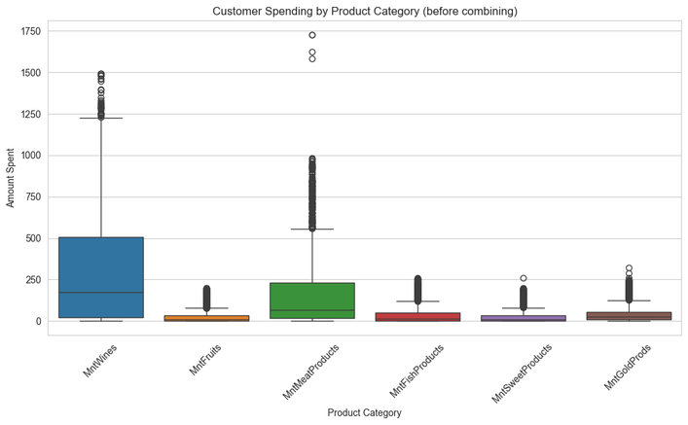
Graphs
Wine dominates spending: MntWines has by far the highest median and widest spread (up to ~1500), showing it's the primary revenue driver among product categories.
Right-skewed distributions with outliers: All categories are heavily right-skewed with numerous high-value outliers, especially MntMeatProducts (outliers up to ~1750), indicating a small segment of high-spending customers.
Low-spend categories cluster together: MntFruits, MntFishProducts, MntSweetProducts, and MntGoldProds show similarly low medians and compressed ranges, suggesting these are secondary/discretionary purchase categories compared to Wines and Meat.
Samsung Innovation Campus

Slide 9
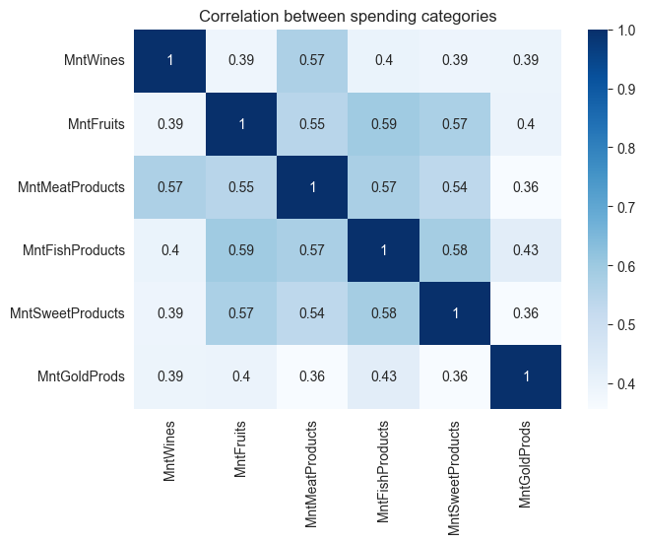
Graphs
Consistently positive correlations: All spending categories show moderate positive correlations (0.36–0.59) with each other, suggesting customers who spend more in one category tend to spend more across others — pointing to overall "high-spender" vs "low-spender" customer segments rather than category-specific buyers.
Fish, Fruits, and Sweets are most tightly linked: MntFishProducts correlates strongly with both MntFruits (0.59) and MntSweetProducts (0.58), hinting at a shared customer group with broader discretionary/gourmet purchasing habits.
GoldProds is the most independent category: MntGoldProds has the weakest correlations with every other category (0.36–0.43), suggesting it's driven by a somewhat distinct purchasing motive rather than general spending level.
Samsung Innovation Campus

Slide 10
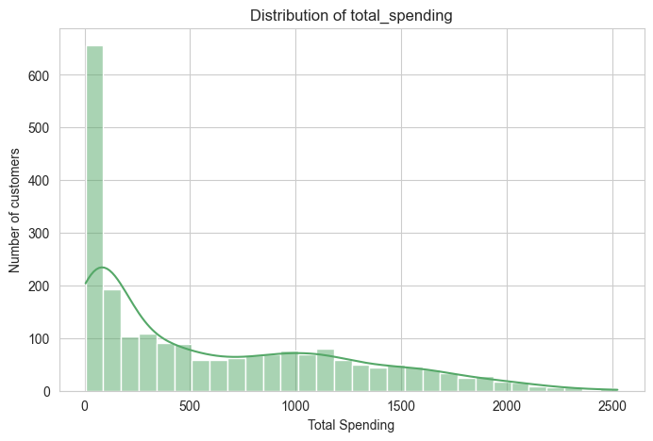
Graphs
Bimodal-like distribution: A large spike of ~650 customers falls in the lowest spending bracket (near 0), followed by a smaller secondary bump around 900–1200, suggesting at least two distinct customer segments — low spenders and moderate/high spenders.
Right-skewed overall: The distribution has a long tail extending to ~2500, meaning most customers spend relatively little while a smaller group of high-value customers drives disproportionately more revenue.
Samsung Innovation Campus

Slide 11
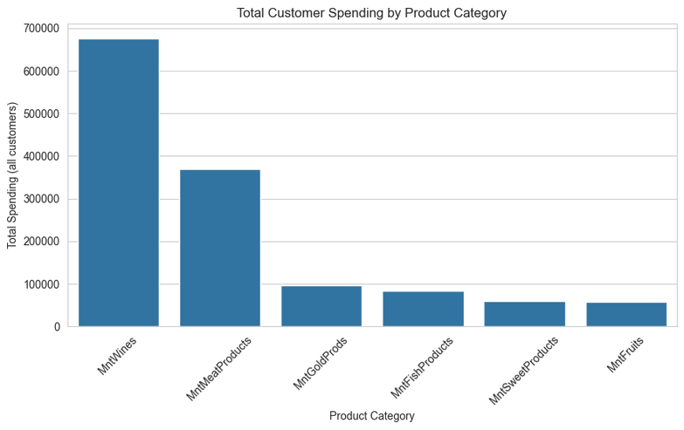
Graphs
Wines lead by a wide margin: MntWines accounts for roughly 675K in total spending — nearly double the next highest category — making it the single largest revenue contributor across all customers.
Wine and Meat dominate combined revenue: Together, MntWines and MntMeatProducts make up the majority of total spending, while the remaining four categories (Gold, Fish, Sweets, Fruits) each contribute under 100K.
Long tail of minor categories: GoldProds, FishProducts, SweetProducts, and Fruits are clustered closely together at the low end, indicating these are niche or add-on purchases rather than core revenue drivers.
Samsung Innovation Campus

Slide 12
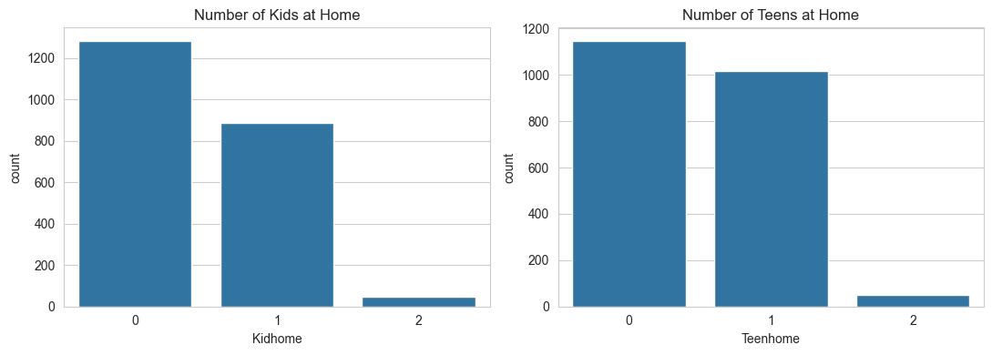
Graphs
Most households have no children: The majority of customers have 0 kids or teens at home (~1,280 and ~1,150 respectively), while very few (under 50) have 2 — indicating the customer base skews toward smaller households.
Similar distribution pattern for kids and teens: Both features follow the same shape — highest at 0, moderate at 1 (~880 and ~1,020), and rare at 2 — suggesting Kidhome and Teenhome could behave similarly as segmentation or predictive features.
Potential for feature engineering: Given their similar distributions and low variance at the high end, Kidhome and Teenhome could be combined into a single "total dependents at home" feature to simplify the model while retaining the household-size signal.
Samsung Innovation Campus

Slide 13
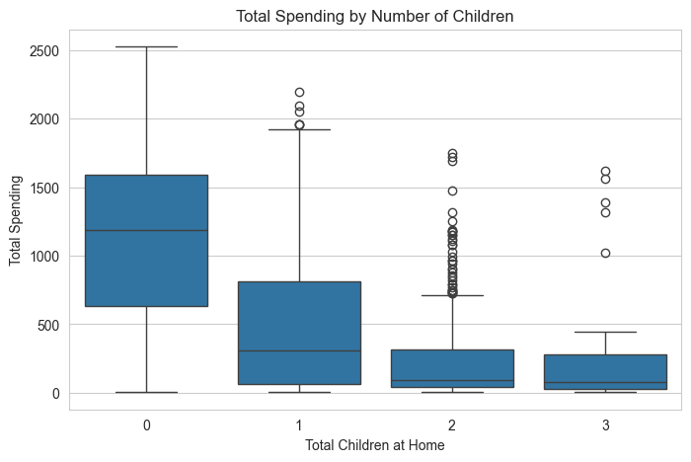
Graphs
Spending drops sharply with more children: Customers with 0 children spend far more (median ~1,200) compared to those with 1 (~300), 2, or 3 children (both under ~100), showing a strong inverse relationship between household size and spending.
Highest variability among childless customers: The 0-children group has the widest spread (up to ~2,500) with no outliers, suggesting this segment includes both budget and high-value customers.
Outliers persist in larger households: Despite lower overall spending, customers with 1–3 children still show occasional high-spending outliers (up to ~2,200), indicating a small subset of large families that remain valuable customers worth targeting.
Samsung Innovation Campus

Slide 14
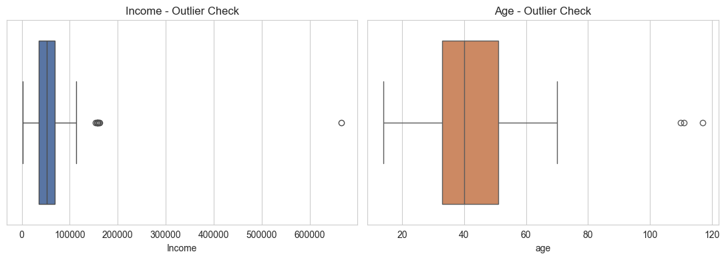
Graphs
Extreme income outlier detected: One customer reports an income near 660,000, far beyond the rest of the distribution (which is mostly clustered under 150,000) — a likely data entry error or genuine extreme value that needs handling before modeling.
Otherwise well-behaved distributions: Excluding these extreme outliers, both Income and Age show reasonably tight, symmetric spreads, meaning a simple outlier removal/capping step should be sufficient to clean the data for clustering.
Samsung Innovation Campus

Slide 15
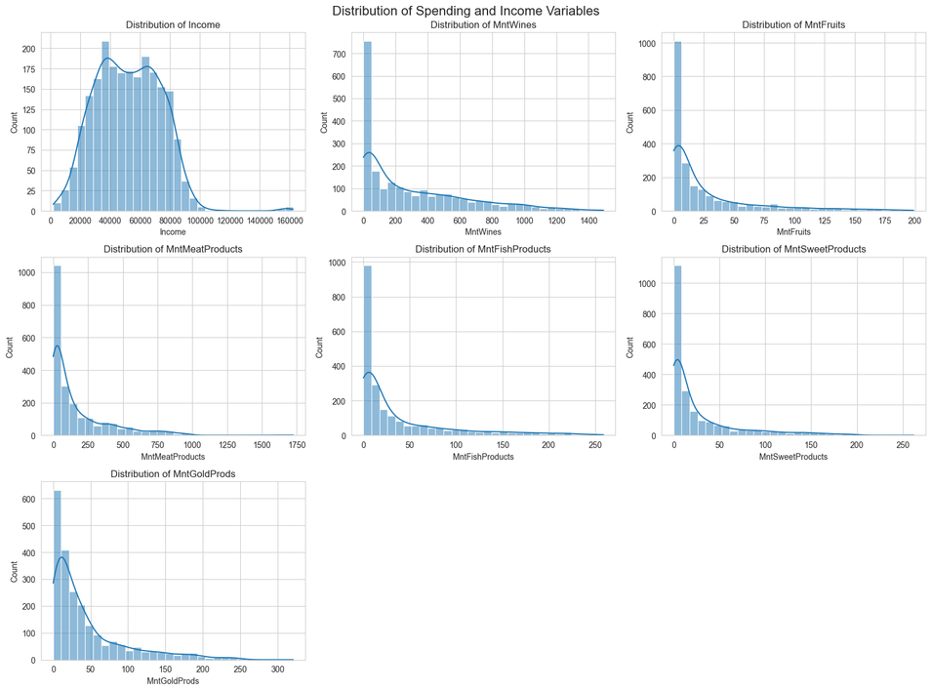
Graphs
Samsung Innovation Campus

Slide 16
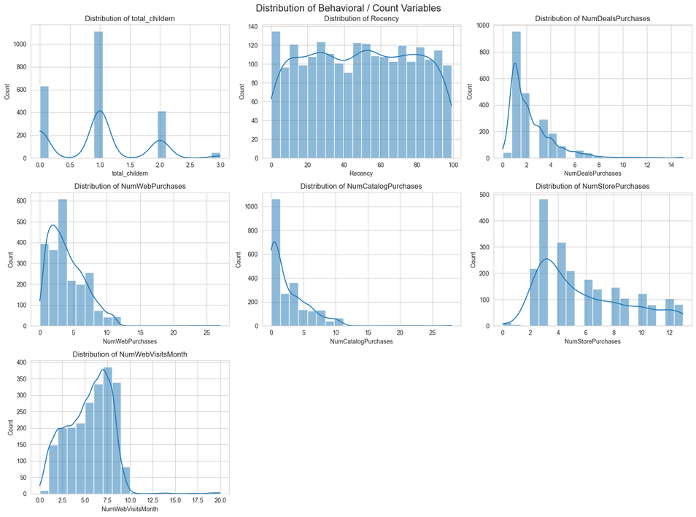
Graphs
Samsung Innovation Campus

Slide 17
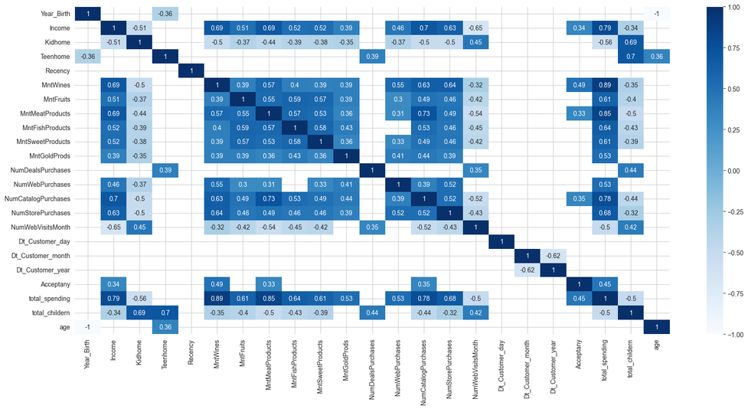
Graphs
Income is the strongest driver of spending: Income correlates very strongly with total_spending (0.79) and individual categories like MntWines (0.69) and MntMeatProducts (0.69), confirming it as the single most important predictor of customer value.
Children reduce spending and web dependence: Kidhome and Teenhome are negatively correlated with total_spending and most Mnt categories, but positively correlated with NumWebVisitsMonth (0.45, 0.36) and NumDealsPurchases — suggesting parents browse more but spend less, and are more deal-sensitive.
Catalog purchases signal high-value customers: NumCatalogPurchases shows strong ties to Income (0.7), total_spending (0.78), and MntMeatProducts (0.73), making it one of the clearest behavioral indicators of a high-spending customer segment — more so than NumWebVisitsMonth, which is negatively correlated with spending overall.
Samsung Innovation Campus

Slide 18
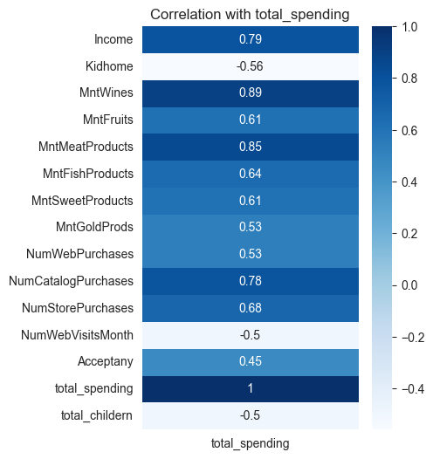
Graphs
Wine and meat spending are the top predictors: MntWines (0.89) and MntMeatProducts (0.85) show the strongest correlations with total_spending, meaning these two categories largely drive overall spending totals — likely because they're the two highest-volume categories.
Household composition negatively impacts spending: Kidhome (-0.56) and total_children (-0.5) are the strongest negative correlates, reinforcing that customers with children spend significantly less overall than those without.
Purchase channel matters more than browsing: NumCatalogPurchases (0.78) and NumStorePurchases (0.68) correlate much more strongly with spending than NumWebVisitsMonth (-0.5), suggesting that customers who buy through catalog/store channels are higher-value than those who merely browse online frequently.
Samsung Innovation Campus

Slide 19
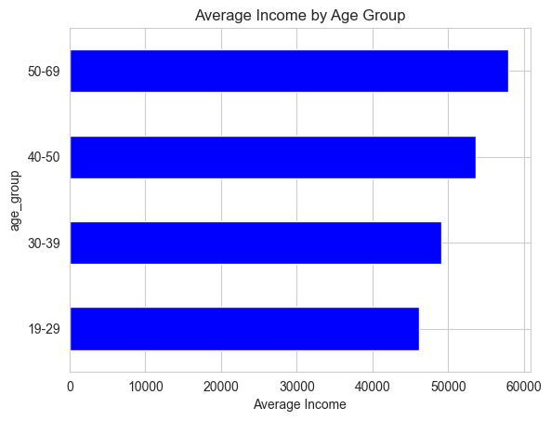
Graphs
Income rises steadily with age: Average income increases consistently from the 19-29 group (~46K) to the 50-69 group (~58K), reflecting typical career progression and earning potential over time.
Older age groups (50-69) are the highest earners: This oldest bracket has the highest average income, making it a potentially valuable segment to target with premium offerings.
Youngest group has the lowest income, but the gap is moderate: The difference between the highest and lowest age groups is only about 12K, suggesting income alone may not sharply differentiate age-based segments — other behavioral features may be needed for finer segmentation.
Samsung Innovation Campus

Slide 20
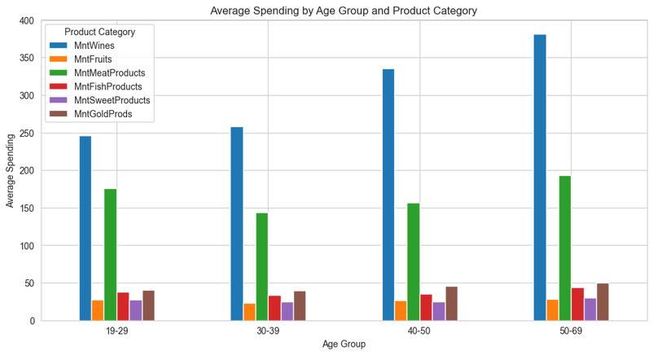
Graphs
Wine spending grows steadily with age: MntWines rises consistently across age groups, from ~245 in the 19-29 bracket to ~380 in the 50-69 bracket, making older customers the strongest wine buyers.
Meat spending peaks in youngest and oldest groups: MntMeatProducts is highest for 19-29 (~175) and 50-69 (~195), but dips for 30-39 and 40-50, suggesting a non-linear relationship rather than a simple age trend.
Minor categories remain flat across ages: MntFruits, MntFishProducts, MntSweetProducts, and MntGoldProds show relatively small, stable spending levels across all age groups, indicating age isn't a strong driver for these discretionary categories — wine and meat are where age-based targeting would have the most impact.
Samsung Innovation Campus

Slide 21
Data cleaning & Pre-processing
Samsung Innovation Campus

Slide 22
Data Cleaning
Delete unnecessary columns
Column | Type | Reason
ID | Identifier | It has no analytical value
Z_CostContact | Constant | One constant value for all rows
Z_Revenue | Constant | One constant value for all rows
Missing values: Checked null values per column, found a small percentage (mainly in Income), so we dropped them since the impact on the data was minimal.
Duplicates: Checked for duplicate rows — none found.
Data type conversion: Dt_Customer was a string, converted to datetime, and split into separate Day / Month / Year columns.
Samsung Innovation Campus

Slide 23
Preprocessing
Feature Engineering
Acceptany (Campaign Acceptance): Sum of all accepted campaigns (AcceptedCmp1-5 + Response). Captures total responsiveness; 27.3% of customers accepted at least one offer.
Totalspending (Total Spending): Aggregates spending across all 6 product categories (Wines, Fruits, Meat, Fish, Sweets, Gold) into a single monetary value.
Total children (Total Children): Combines Kidhome + Teenhome to capture total household dependents.
age_group (Age Bins): Categorizes continuous Age into 5 age brackets (19–29, 30–39, 40–50, 50–69, 70+) to enable demographic segmentation.

Slide 24
Preprocessing
Outlier Detection & Handling
Detected Outliers: Identified erroneous extreme values in Age (110–117) and Income(666,666 vs. next highest ~162,397), likely due to data-entry errors.
Encoding
Ordinal Encoding (Education): Applied to capture the implicit rank/order among education levels (e.g., Basic < Graduation < Master < PhD).
One-Hot Encoding (Marital Status): Used for categorical values with no inherent order to prevent creating false numeric relationships.
Transformation (Skewness Correction)
Skewness Detected: Spending variables showed strong right-skewness (Wines: 1.17, Gold: 1.84, Fish: 1.92, Meat: 2.03, Fruits & Sweets: 2.10).
Log Transformation (log1p): Applied log(1 + x) across all spending features (Mnt* and total_spending) to reduce right-skewness and minimize outlier impact.

Slide 25
Machine Learning Model
Samsung Innovation Campus

Slide 26
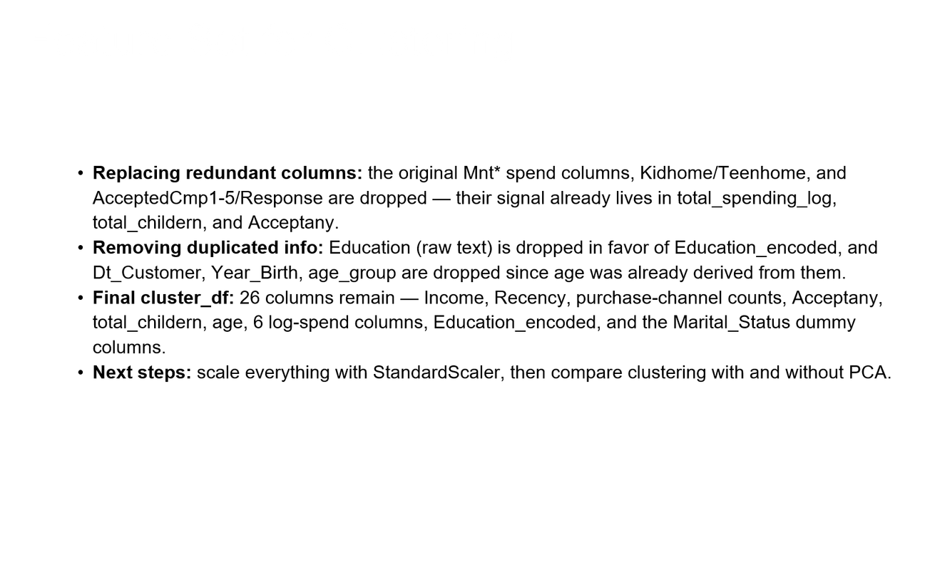
Samsung Innovation Campus

Slide 27
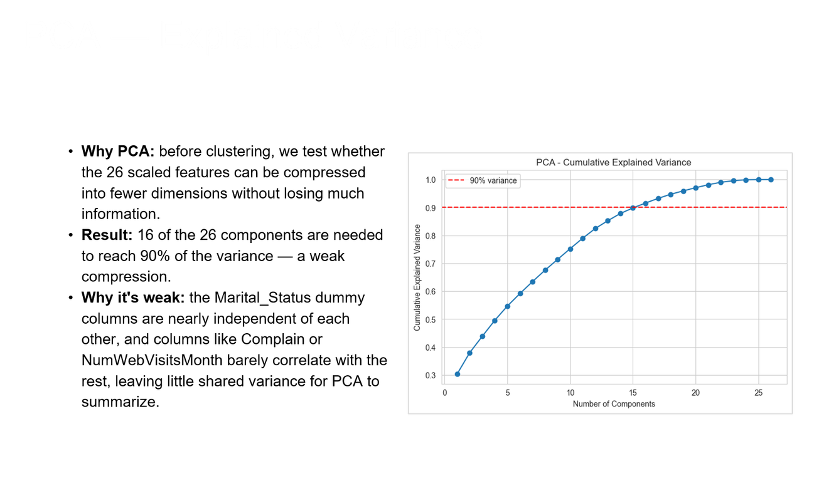
Samsung Innovation Campus

Slide 28
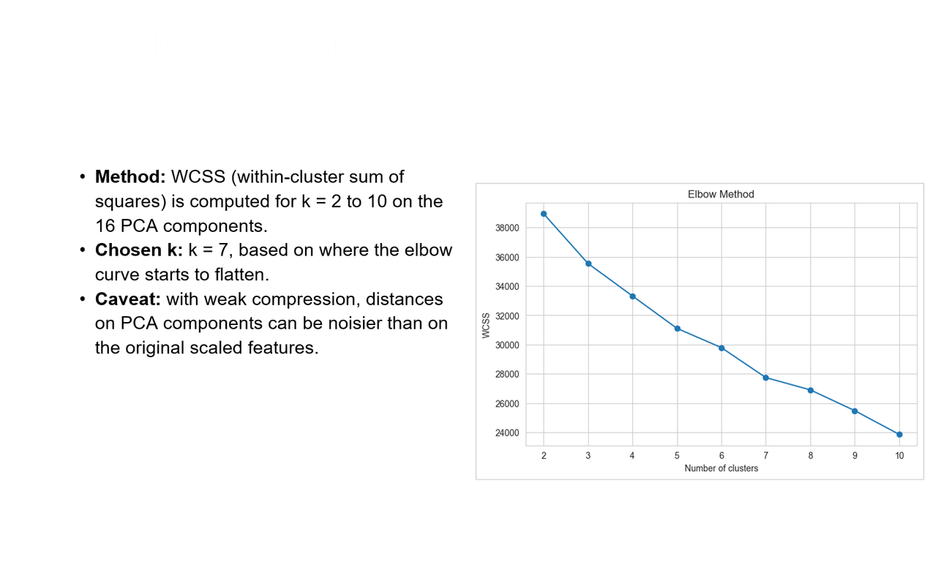
Samsung Innovation Campus

Slide 29
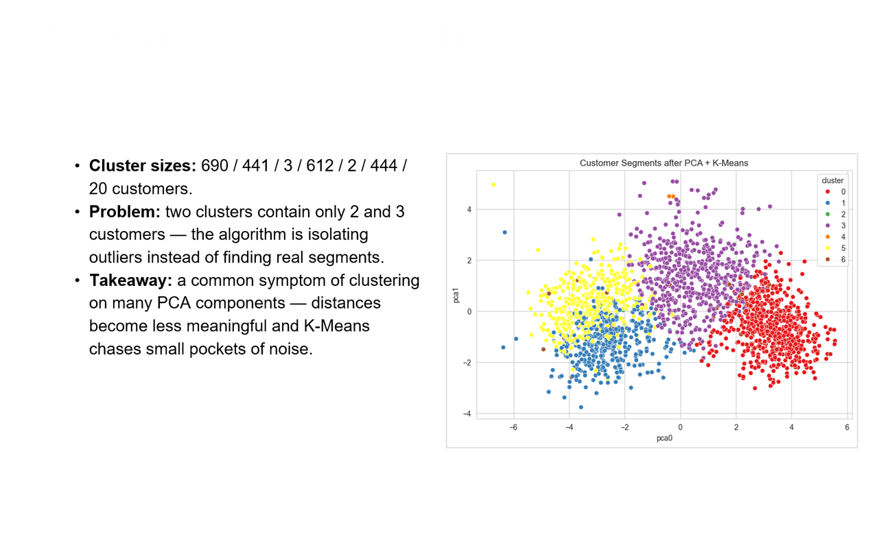
Samsung Innovation Campus

Slide 30
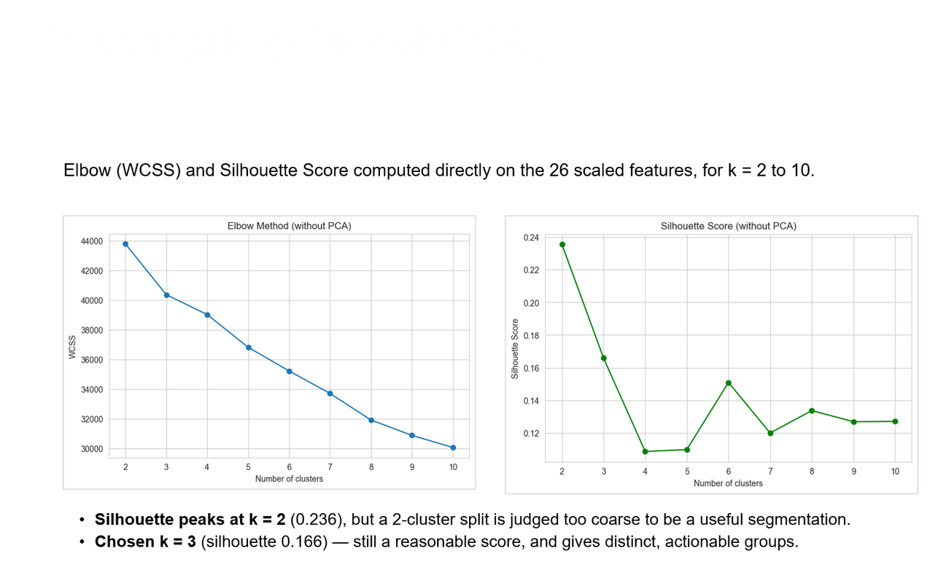
Samsung Innovation Campus

Slide 31
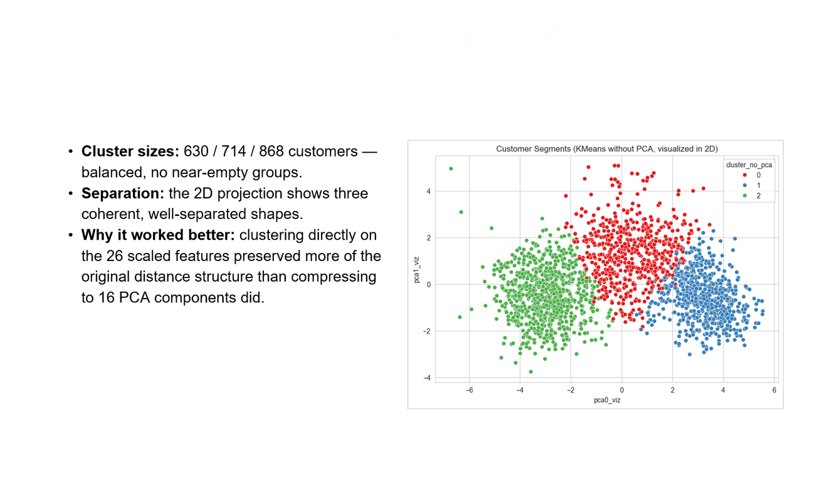
Samsung Innovation Campus

Slide 32
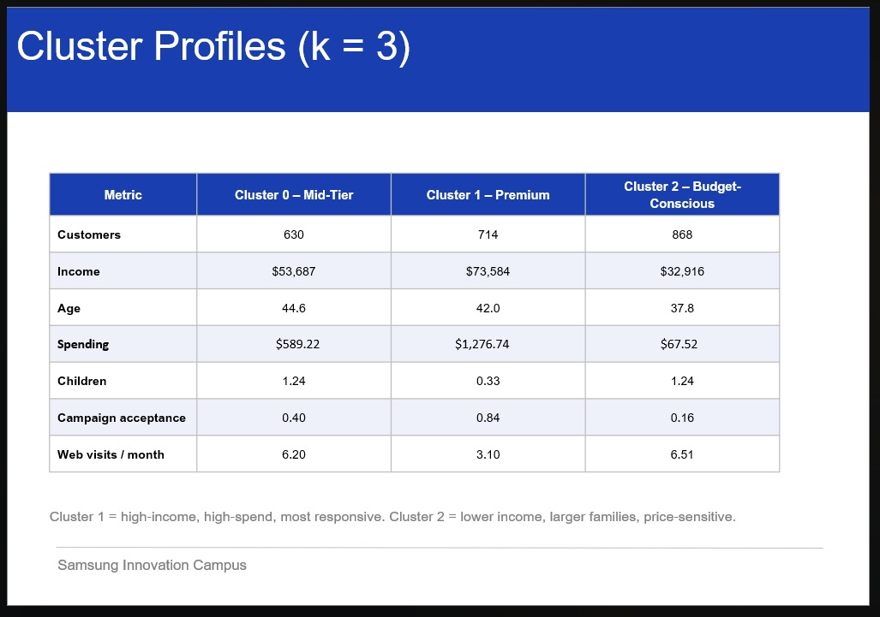
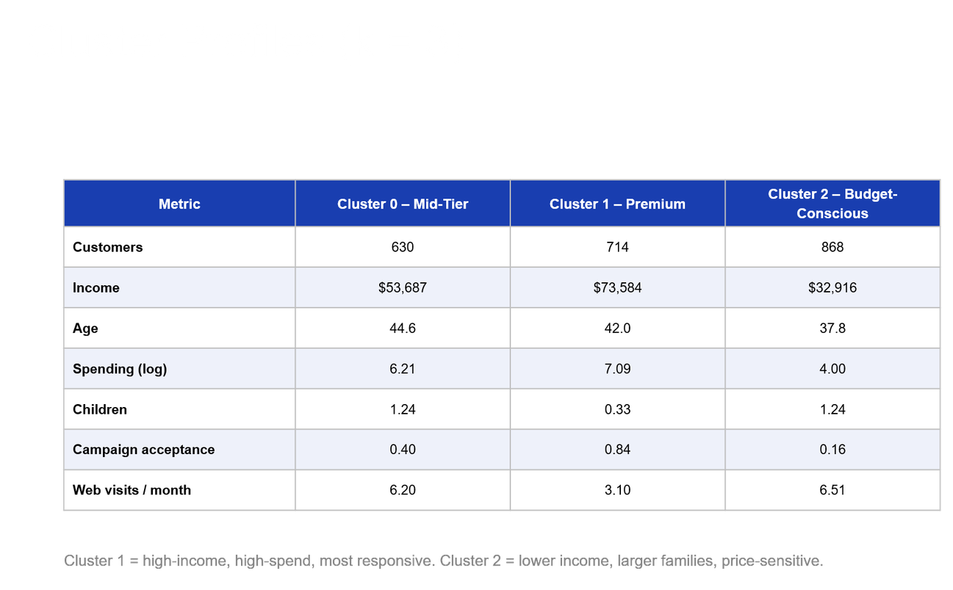
Samsung Innovation Campus

Slide 33
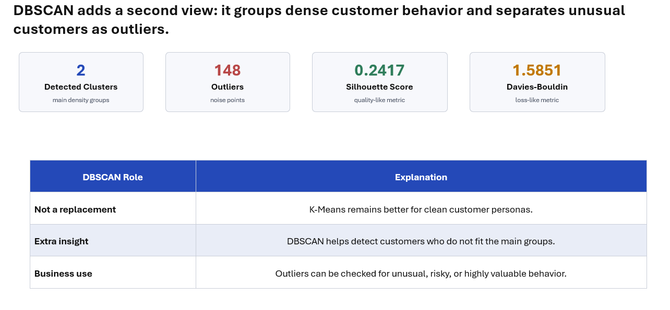
DBSCAN (Deep Scan) Results
Samsung Innovation Campus

Slide 34
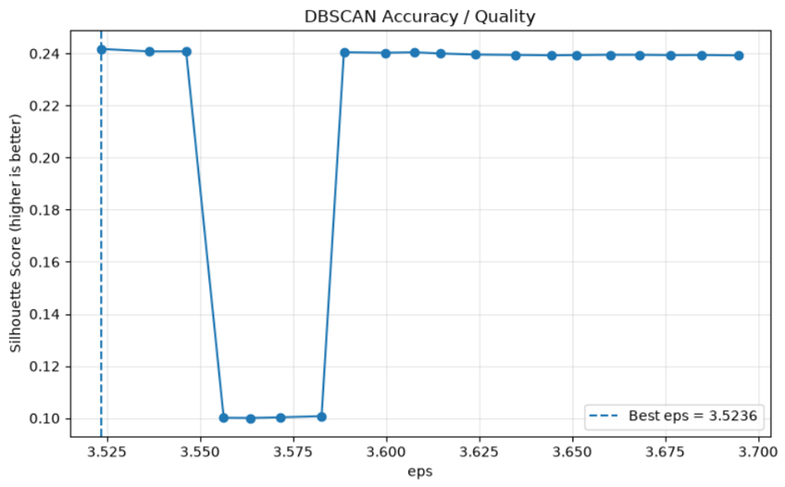
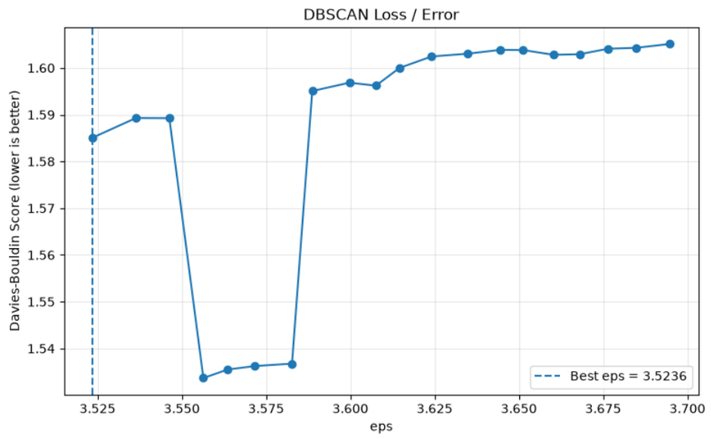
Charts
Samsung Innovation Campus

Slide 35
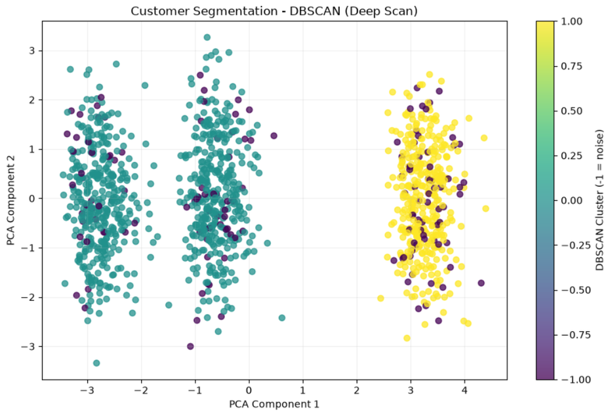
Charts
Samsung Innovation Campus

Slide 36
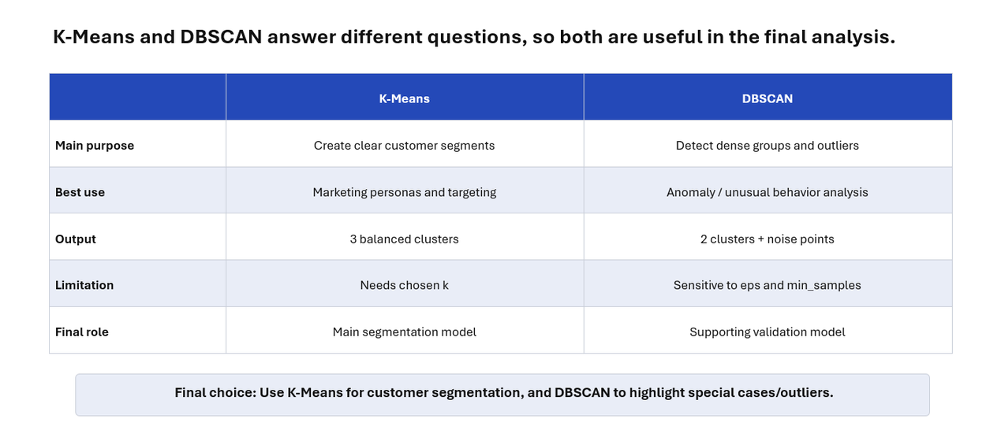
Model Comparison
Samsung Innovation Campus

Slide 37
Conclusion
Customer segmentation successfully identified different behavioral and spending patterns among customers.
K-Means provided clear and structured customer groups.
DBSCAN added extra value by detecting outliers and unusual customer behavior.
Features such as income, spending, purchase channels, and campaign response were important in distinguishing customer segments.
The final segmentation can support better targeting, personalized marketing, customer retention, and more efficient campaign decisions.
Samsung Innovation Campus

Slide 38
Our Recommendation
Focus on high-value customers with personalized offers, loyalty programs, and premium promotions.
Target customers who visit the website frequently but purchase less with better recommendations and special discounts.
Use different marketing campaigns for each customer segment based on spending, income, and campaign response.
Analyze DBSCAN outliers separately, as they may represent unusual or potentially valuable customer behavior.
Update the segmentation periodically as customer behavior changes over time.
Samsung Innovation Campus

Slide 39

ⓒ2020 SAMSUNG. All rights reserved.
Samsung Electronics Corporate Citizenship Office holds the copyright of book.
This book is a literary property protected by copyright law so reprint and reproduction without permission are prohibited.
To use this book other than the curriculum of Samsung innovation Campus or to use the entire or part of this book, you must receive written consent from copyright holder.

